Slide 1

The Power of Controversy
The proper usage of social networks.

Slide 2
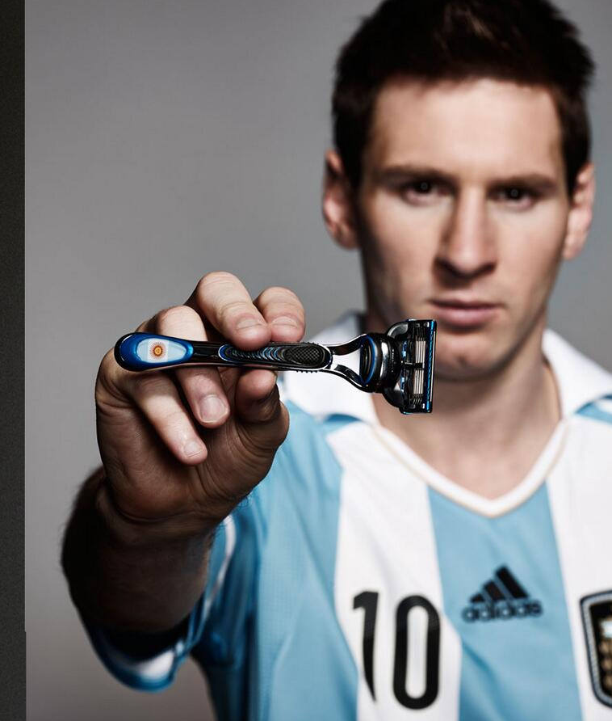
Up to come…
The Gillette Company
Quick SWOT Analysis
Competitors and the Market
Some Awards
[Movie Time]
Purpose of our Ad
What we are trying to associate our trademark to
What we are trying to portray our company to
How we are trying to gain new market share
Some Numbers
Some Creations as Reference
What we are trying to appeal our customers about
How we are reaching our target
[Q/A Time]

Slide 3
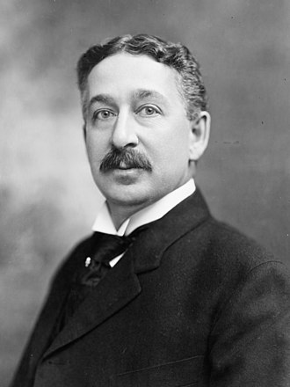
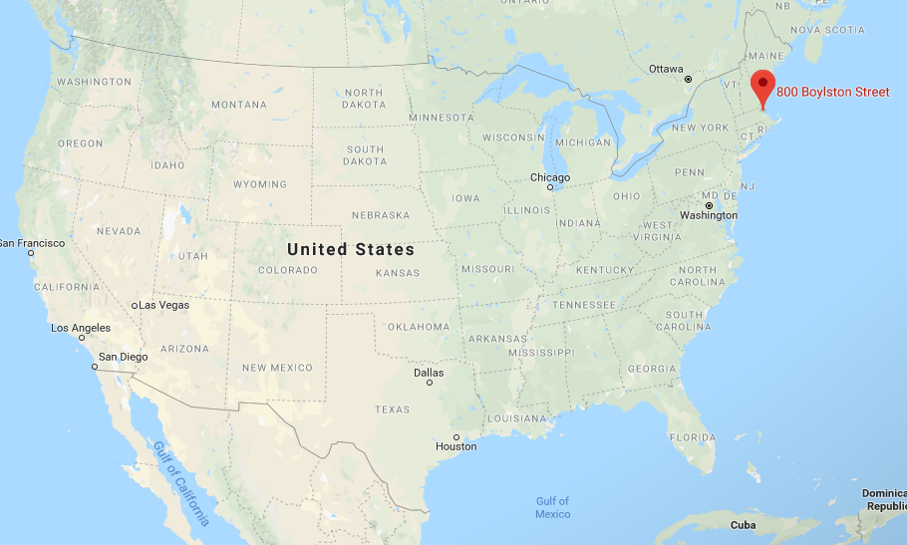
0 – Introduction
, Boston, Massachusetts, U.S.
Since 1901
King Camp Gillette
January 5, 1855 – July 9, 1932
Aged 77 years

Slide 4
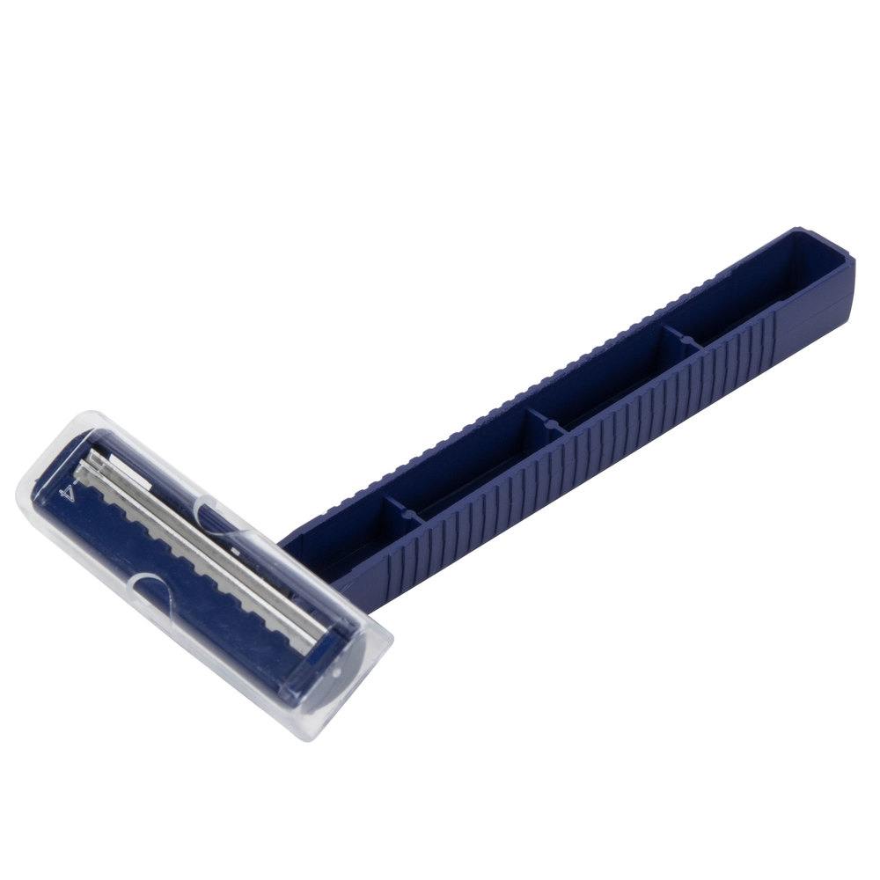
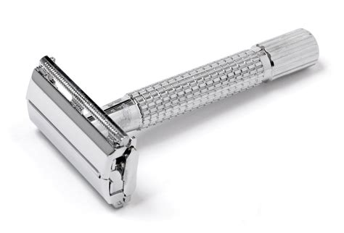
Past Products
Safety razor – 1901
Twin bladed razor – 1972
Twin bladed disposable razor -1976
Pivoting head razor – 1979
Pivoting head disposable razor – 1980
Razor designed specifically for women – 1992
Triple blade razor – Mach 3 1998
Battery-powered razor – M3Power 2004

Slide 5
1 – Knowing the company in depth
Strengths
Weaknesses
Market Leader
Strong Brand Image
Aggressive Advertising
Quality & Innovation
Portfolio Range
Long Development Cycles
Relatively Static Market Growth
High Costs Of Products
Expensive Brand Maintenance
Opportunities
Consumer Brand
Demand for High Quality
New Production/ Technology
Expansion of Production & Distribution
Threats
New Competitors
Increasing Buyer Power
Growth in Substitutes
Electric Shaving Technology
Economic Downturn
Notes:
Gillette spends billions of dollars on its advertising - emotional marketing strategy
over six continents and in more than 180 countries
spends a huge share on R&D

Slide 6



2 – Knowing our competitors and our market
cheap disposable
aggressive ads
&
5% cheaper
new to the market
Notes:
BIC: cheap disposable

Slide 7
3 – Recognizing our power on customers
All in a single year…
Dupont Awards for Packaging Innovation
Edison Best New Product Awards
CEW Beauty Awards
Better Homes & Garden's Best New Product Award
Allure Best of Beauty Awards
Maxim Grooming Awards
Men's Health Grooming Awards
Instinct Grooming Awards
Esquire Grooming Awards

Slide 8
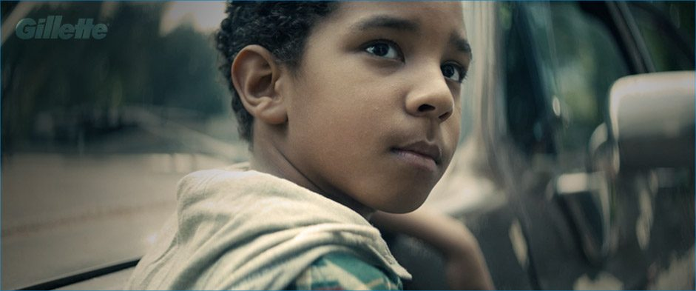

Notes:
https://www.youtube.com/watch?v=IPPf3sZIo-Q

Slide 9
What are we trying to get associated with our trademark?
Our trademark is:
The trademark of change;
For every gender;
Supporting the #MeToo movement;
Taking actions in our society.
Notes:
Video at 0:06.

Slide 10
What are we trying to portray our company to?
Our company is:
Is open, where women are treated equally as men;
A place where women are safe and don’t have to worry;
A chill corp.;
A modern and a “startup” mindset corp.
Notes:
Video at 0:06.

Slide 11
Purpose of this ad: gaining new market shares
Get attention from our target audience
Controversy
Common topics and issues
Engage them positively
Participate to the issues of women shaving
Show them our trademark is accepting them
Notes:
Getting attention of the women by:
Being controversial
Talking about common issues

Slide 12

Engaging Women Positively
Gaining New Market Shares
Notes:
Then, engage women to make them want to buy.

Slide 13

Engaging women, associate positivity to the company: Show them our trademark is accepting them
Gillette’s Gender Breakdown
Shaving Conversation Gender Breakdown
Data from:

Slide 14
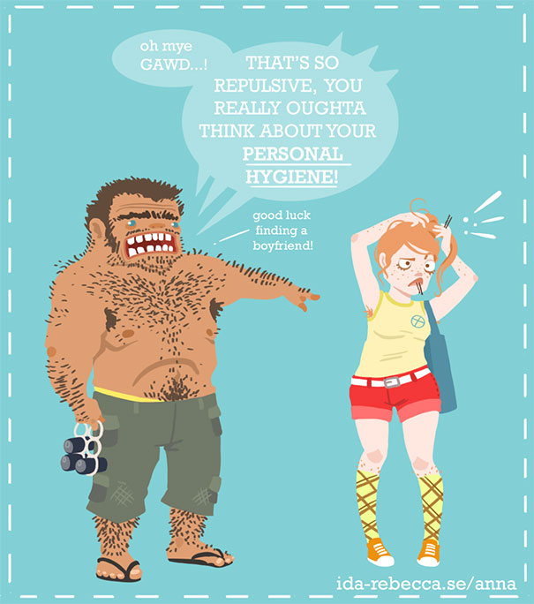
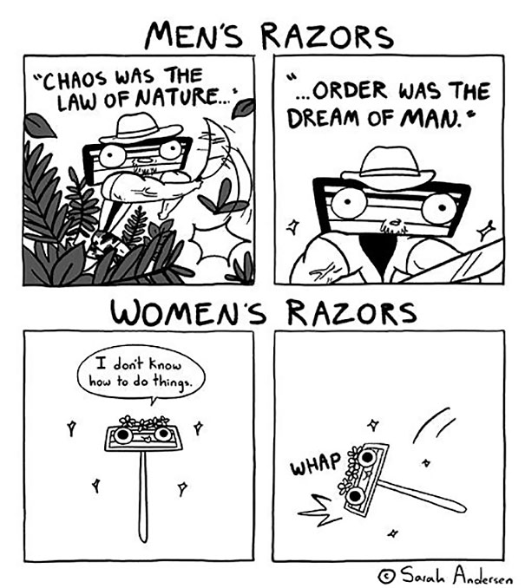

Engaging women by participating to: The issues of women shaving
Society expectations
Hate of shaving
It’s costing too much
Notes:
Participating to the issues of women shaving.

Slide 15
“The Best a Man Can Get” (1989–2019) “The Best Men Can Be” (2019–)
Engaging women: Show our trademark is accepting them

Slide 16
What are we trying to appeal them?
Our trademark is:
An example for others, especially children.
Not only for men, unlike we made it believe.
Respecting and treating women equally and properly, women should use our products.
Notes:
Video at 0:06.

Slide 17


How to persuade to buy our products: Reaching our targets
By “discussing” about the issues (through the ad.)
By taking a stance on a political issue, everyone has a stance:
People share their mind out.
People see it.
They take action.

Slide 18
Discussion time!
Would you be more likely to buy a product from a trademark that shows the same stances as you?
Do you think using political stances for advertising is okay?
What do you think about reacting to ads on social medias? Would you do it?

